Slide 1
Rules, Knowledge Base and Algorithms: Automated analysis of compound types in Sanskrit
Amrith Krishna, Pavankumar Satuluri, Shubham Sharma, Apurv Kumar and Pawan Goyal
Dr. Pawan Goyal
Department of Computer Science & Engineering
Indian Institute of Technology, Kharagpur, WB, India

Slide 2
Compounding
Means of vocabulary expansion
Two words or more words join together to form new word
concatenative or non-concatenative
Compound analysis is computationally challenging
compounds are highly productive in nature,
the relation between the components is implicit
the correct interpretation of a compound is often dependent on contextual or pragmatic feature
Su Nam Kim and Timothy Baldwin. 2005. Automatic interpretation of noun compounds using wordnet similarity. In International Conference on Natural Language Processing, pages 945–956. Springer.

Slide 3
Compounds Word Usage
Vocabulary share –
In German, 47 % vocabulary share
Sanskrit – 75 % (from the DCS corpus of 3.2 million tokens)
In English, compounds usage is estimated to be less
3 – 4 % words in the vocabulary take part in compound formation
43 % of vocabulary in Sanskrit take part in compound formation.
In Sanskrit, compounds with multiple components are also widely used

Slide 4
Compounding
f(boat,house) -> boathouse
f(pale,face) -> paleface
f(bitter,sweet) -> bittersweet
In Sanskrit, the relations are abstracted into 4 broad classes based on the headedness of compound.
Identifying the head of the compound can be useful.
There are further fine-grained classification of compounds as well in Sanskrit, though we will not be discussing them.

Slide 5
Headedness of compounds in Sanskrit
Avyayībhāva
Upa + kr̥ṣṇaḥ -> upakr̥ṣṇam - Near to Krishna
The head is an indeclinable
Upa is the head here
Compound also becomes an indeclinable
Tatpuruṣa
Endocentric compounds
Second component is generally the head
rājapuruṣaḥ : ‘rajnah puruṣaḥ’ i.e. King’s man
rājan (genitive)+puruṣaḥ
Karmadhāraya compound or descriptive compounds is a sub-type

Slide 6
Headedness of compounds in Sanskrit
Bahuvrīhi
Exocentric
Refers to an external entity
‘pītāmbaraḥ’ – ‘’pītam ambaram yasya saḥ”, The words pītam (yellow) and ambaram (cloth) collectively refer to Lord Vishnu
Dvandva
Copulative compounds
All the components are heads
mātāpitarau – Mother and Father (The case is dual for the compound)

Slide 7
Regularities of Compounds in Sanskrit
Concatenative
Strict preference for the ordering of the components.
Subject to all the inflectional and derivational modifications applicable to nouns
Affixation occurs at the end of the compound and not within the components
rājñaḥ puruṣaḥ --> rājan ṅas puruṣaḥ → rājapuruṣaḥ
rājapuruṣasya (after inflection in 6th case)
Any compound can be analysed by decomposing it into two immediate component nouns

Slide 8
Multi-class classification
Given a compound, we need to identify the type of the compound i.e. one of the four classes
How can a system identify the compound type?
Supervised learning - We give examples of different types of compounds to the system
We also need to provide relevant details about the compound explicitly to the system
The explicit information is given as features and system learns what values of features is related to which particular class

Slide 9
Multi-class classification
Dataset
UoHyd
Labelled with human supervision
32000 unique labelled compounds with compound splits
Collected from various ancient manuscripts
Imbalanced data
Tatpurusha instances are highest, under-sampled to match with bahuvrihi data samples
Evidence for Avyayibhava class is 5 % of the bahuvrihi class
< 10,000 labelled instances
80 – 20 Split Training & Held-out dataset

Slide 10
Features – Rules from Aṣṭādhyāyī
Grammar for Sanskrit was defined 2500 years ago
Aṣṭādhyāyī is an integral part of the grammar with 4000 rules
400 of the rules state about compound formation in Sanskrit
Less than 100 of the rules are conditional rules in nature, and has been incorporated in the framework

Slide 11
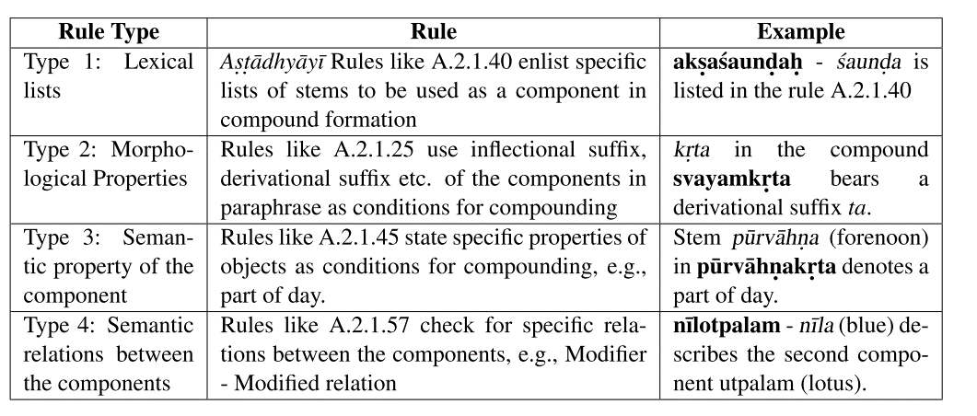
Features – Rules from Aṣṭādhyāyī
Amba Kulkarni and Anil Kumar. 2013. Clues from Aṣṭādhyāyī for compound type identification. In 5th International Sanskrit Computational Linguistics Symposium (SCLS).

Slide 12
Features – Relations from Lexicon
Amarakośa
an ancient dictionary of 11580 words (9031 unique lemmas) in altogether 4035 synsets.
six relations (was implicit in the original manuscript, was made explicit later )
‘part-whole’,‘is a kind of’ and ‘master-possession’ – Tatpuruṣa
‘child-parent’ and ‘husband-wife’, - Dvandva
Gender information - Bahuvrīhi
pītāmbaraḥ and pītāmbaram
Sivaja S Nair and Amba Kulkarni. 2010. The knowledge structure in Amarakośa . In Sanskrit Computational Linguistics, pages 173–189. Springer.

Slide 13
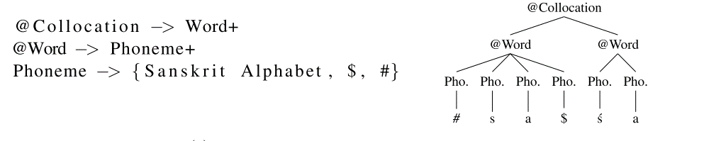
Features – Variable length character n-grams
Adaptor Grammars
PCFGs where non-terminals are fixed and productions are learnt from data
Separate grammars for each class
Filtered by cross entropy with a grammar learnt with unified data
Mark Johnson, Thomas L Griffiths, and Sharon Goldwater. 2006. Adaptor grammars: A framework for specifying compositional nonparametric bayesian models. In Advances in neural information processing systems, pages 641– 648.

Slide 14
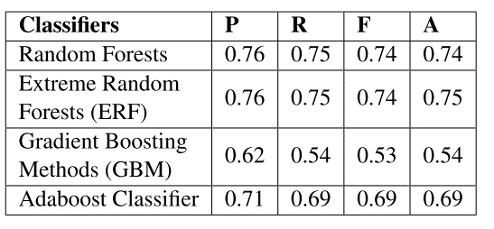
Multi-class classification
Due to Large feature space and modest size of training data, the performance of SVM and decision tree classifiers were near to chance
To handle class imbalance we used easy-ensemble approach
we form multiple training sets, data samples in the minority classes remain intact whereas the majority classes are under-sampled to a defined proportion.

Slide 15
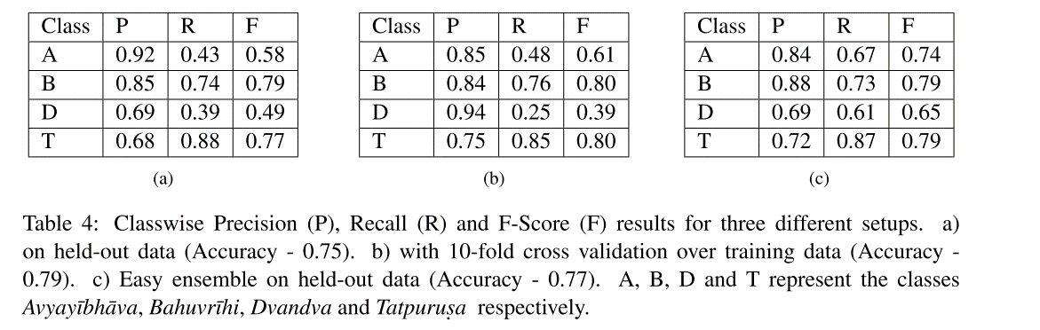
Results

Slide 16
Feature Analysis
Sl.No | Feature Set | Accuracy
1. | Aṣṭādhyāyī Rules | 59.34 %
2. | 1 + Amarakośa | 63.81 %
3. | 2 + Adaptor Grammar | 75.18 %

Slide 17
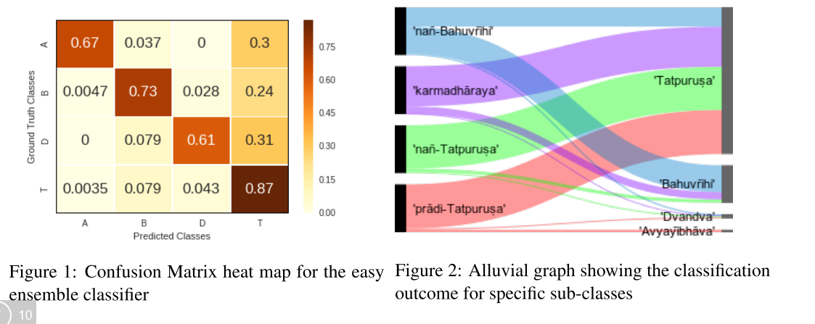
Fine-grained Analysis

Slide 18
Conclusion
Ensemble based classifier for the task
Linguistically motivated Features
Effectiveness of Amarakośa and Adaptor grammars for the task
Effectively incorporated features from Aṣṭādhyāyī and from corpus usage
Challenges due to lack of context
Case of same final form, but different classes like aputraḥ, ativanam etc.

Slide 19
Same word for multiple types
nīlotpalam- nīla + utpala : Both Tatpuruṣa and Bahuvrīhi
aputraḥ -
na putraḥ (nañ-Tatpuruṣa )
avidyamānaḥ putraḥ yastya saḥ (nañ-Bahuvrīhi)
ativanam
vanasya atyayaḥ (Avyayībhāva)
vanam atikrāntaḥ (Tatpuruṣa)
Either context or canonical paraphrase is required

Slide 20
Thank You

